Slide 1
The change of heart surgeries Mortality Rate in 1982 JUL-DEC
---Wenru Zhou
Goal: whether certain VA hospitals have too high (or low) of death rate from heart surgeries compared to a hospital level risk adjusted estimate of death risk
Data summary:
Total number of hospitals: 44
Total time period: 3 years (6 month as unit)
Outcome: 30 day mortality per 100 heart surgeries per six month
Covariates: Procedures, patient’s condition and BMI
Method:
Missing pattern of each variables were checked.
Observed death rate were calculated using period 39
logistic regression were used to estimate the death rate for period 39. Confidence interval was built using bootstrap with number of dataset=1,000

Slide 2
Data check, missing values and patterns
Outcome related:
A patient who died in 30 days is more likely to have missing procedure
(OR=1.705, 95%CI: 1.125 2.586).
A person who died in 30 days is more likely to have missing BMI
(OR= 2.377, 95%CI: 1.711 3.302)
A patient who died in 30 days is more likely to have missing patient’s condition
(OR=1.537, 95%CI: 1.038 2.275).
All of them are MAR
Data check:
3 BMI outlier-fixed by weight and height
Weight of hospital 1-15 at period 39 should be kg
Deleted 2 observations with procedure=2
Combined 1 and 2 for patient’s condition
Missing table
Variable | Missing (total=26491)
Procedure | 2.03%
Patient’s condition | 2.52%
Weight,lb | 2.51%
Height, inches | 2.51
BMI, kg/cm ^2 | 2.51%
Albumin | 49.92%
Covariate related:
A patient with missing BMI is less likely with missing procedure
Hospital 30 at period 39 had all weight, height and BMI missing.
Hospital17, 34 and 39 has higher missing in patient’s condition compared to other hospitals
A patient with non-missing procedure is more likely to have missing patient’s condition
A patient with BMI missing are less likely to have missing patient’s condition
A patient with missing Patient’s condition tends to have larger BMI
All of them are MAR
We tested the missing status of each variables verses
Other variables
Missing status of other variables
Method: t-test, Welch-Satterthwaite T-Test, chi-sq test, fisher exact test and logistic regression
Not related to any variables (MCAR):
The missing of albumin does not relate to any other variables or the missing of other variables.

Slide 3
Table 1. Characteristics
Years | Period 34-38 |  |  |  | Period 39
Characteristics | All (N=20622) | Alive (N=20096) | Dead (N=526) | P value | All (N=4011) | Alive (N=3911) | Dead (N=100) | P value
Patient's condition | N=20622 | N=20096 | N=526 | <.0001 | N=4011 | N=3911 | N=100 | <.0001&
1, 2 | 942(4.6%) | 933(4.6%) | 9(1.7%) |  | 171(4.3%) | 169(4.3%) | 2(2.0%)
3 | 6364(30.9%) | 6285(31.3%) | 79(15.0%) |  | 1254(31.3%) | 1239(31.7%) | 15(15.0%)
4 | 12216(59.2%) | 11829(58.9%) | 387(73.6%) |  | 2363(58.9%) | 2290(58.6%) | 73(73.0%)
5 | 1100(5.3%) | 1049(5.2%) | 51(9.7%) |  | 223(5.6%) | 213(5.4%) | 10(10.0%)
Procedure | N=20622 | N=20096 | N=526 | <.0001 | N=4011 | N=3911 | N=100 | 0.510
Valve surgery | 4074(19.8%) | 4004(19.9%) | 70(13.3%) |  | 703(17.5%) | 683(17.5%) | 20(20.0%)
CABG surgery | 16548(80.2%) | 16092(80.1%) | 456(86.7%) |  | 3308(82.5%) | 3228(82.5%) | 80(80.0%)
BMI,kg/cm² | N=20622 | N=20096 | N=526 | <.0001 | N=4011 | N=3911 | N=100 | 0.196
(Mean, median) | (28.2,28.2) | (28.2,28.1) | (29.6,29.6) |  | (28.2,28.2) | (28.2,28.2) | (28.7,28.7)
(25th, 75th quantile) | (25.5,30.9) | (25.5,30.9) | (26.9,32.4) |  | (25.4,30.9) | (25.4,30.9) | (26.0,31.9)
(Minimum. Maximum) | (15.8,45.0) | (15.8,42.9) | (17.3,45.0) |  | (17.1,42.3) | (17.1,42.3) | (19.1,38.5)
Albumin,g/dL | N=10338 | N=10068 | N=270 | 0.354 | N=2015 | N=1969 | N=46 | 0.496
(Mean, median) | (4.0,4.0) | (4.0,4.0) | (4.0,4.0) |  | (4.0,4.0) | (4.0,4.0) | (4.0,4.0)
(25th, 75th quantile) | (3.7,4.4) | (3.7,4.5) | (3.6,4.4) |  | (3.6,4.4) | (3.6,4.4) | (3.7,4.2)
(Minimum. Maximum) | (1.8,6.1) | (1.8,6.1) | (2.5,5.7) |  | (2.2,6.3) | (2.2,6.3) | (3.0,5.5)
Largest
category
& fisher exact test is used
* Missing in patient’s condition, procedure and BMI have been excluded
The only categories that
have more different

Slide 4
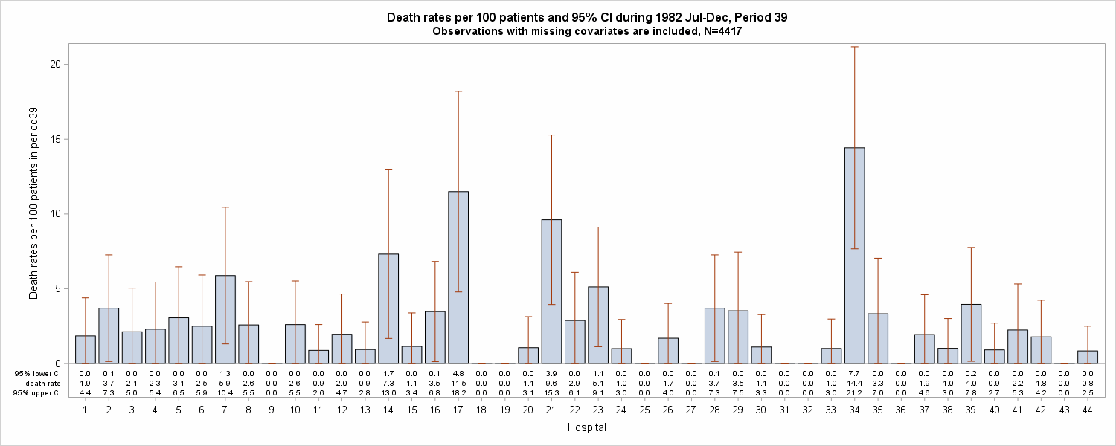
Hospital 17:
11.5(4.8, 18.2)
Hospital 34:
14.4(7.7, 21.2)
Hospital 21:
9.6 (3.9, 15.3)

Slide 5
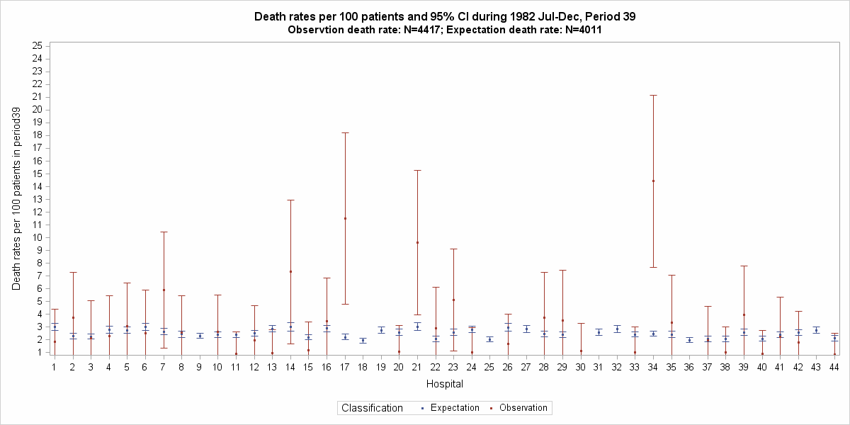
Hospital 34:
Observation: 14.42(7.67,21.18)
Expectation: 2.48(2.27,2.7)
Hospital 17:
Observation: 11.49(4.79,18.2)
Expectation: 2.2(1.98,2.43)
Hospital 21:
Observation: 9.62(3.95,15.28)
Expectation: 3.03(2.74,3.35)

Slide 6
Results and discussion
Results:
3 hospitals (6.98%), which are hospital 17, 21 and 34, had more severe death rates in period 39 than expectation.
9 hospitals (20.93%), which are hospital 9, 18, 19, 25, 27, 31, 32, 36 and 43, had zero death rates in period 39, which are better than expectation Death rates from other hospitals (72.09%) did not change much.
Hospital 30 is excluded from comparison because of missing BMI.
Discussion:
Wide confidence interval: We can use bootstrap method to create a large number of samples (for example, 1x10⁵) from each hospital during period 39, and then calculate the mean death rate and confidence interval.
50% missing in albumin: Although it did not show significance in univariate test (p=0.496), we still tried ROC analysis, and albumin definitely increased the AUC (from 0.6316 to 0.6377, N= 10338).

